Slide 1

Description of Components Project: Smart Medicine Reminder and Vending Machine
Instructor: Prof. Mike Aleshams
Submitted by: Suman Mosam C0770660
Individual Meeting no: 1

Slide 2
Table of Contents
Alexa Echo Dot (3rd Generation)
Raspberry pi 4 model B Board
Arduino Uno
NEMA 17 stepper motor
Stepper Driver (DRV8825)
HD44780 series LCD Display (20*4)
PIR Motion Sensor
Raspberry pi Camera V2 – 8MP
Breadboard and Jumper wires
10. Soldering Kit
11. Digital Multimeter
12. Medicine boxes
13. Invoices of components ordered

Slide 3
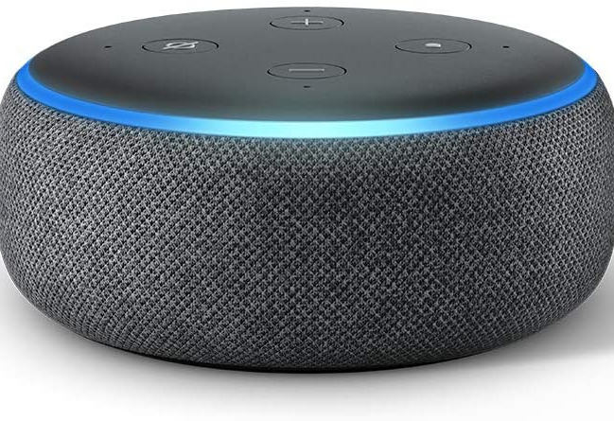
Alexa Echo Dot 3rd Generation
With a new speaker and design, Echo Dot is a voice-controlled smart speaker with Alexa
Most popular smart speaker with a fabric design. It is the most compact smart speaker that fits perfectly into small spaces.
Better speaker quality than Echo Dot Gen 2 for richer and louder sound.
Set alarms, control compatible smart home devices, and more.
Built with multiple layers of privacy protections and controls, including a microphone off button that electronically disconnects the microphones

Slide 4
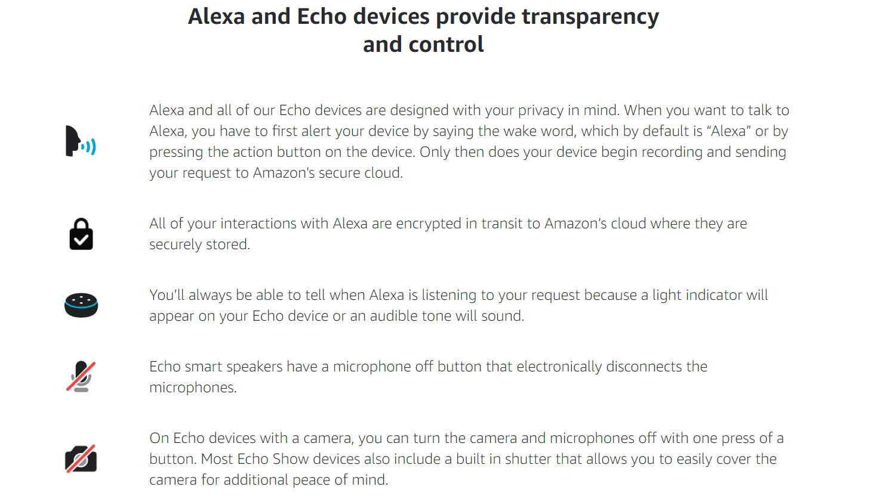
Alexa Echo Dot 3rd Generation

Slide 5
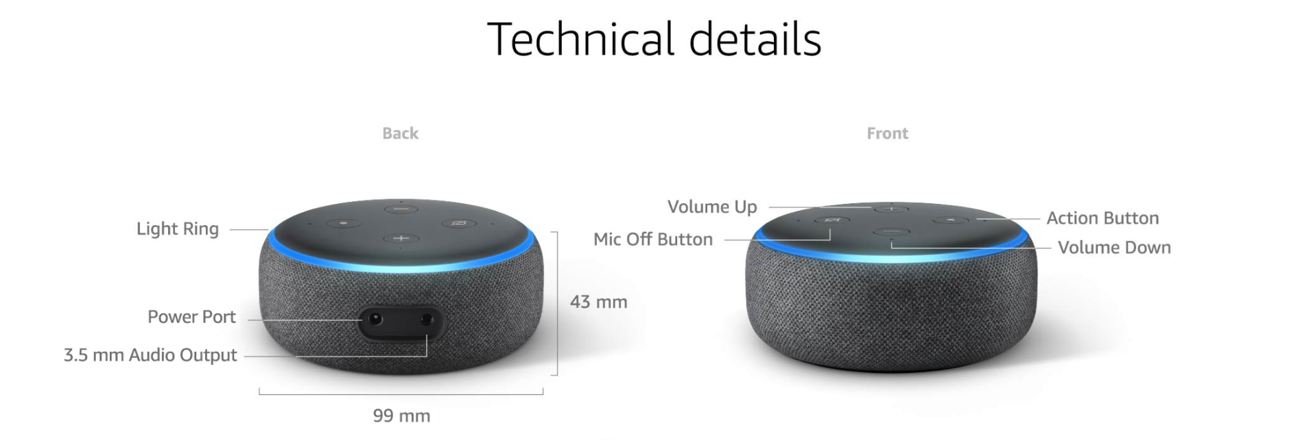
Alexa Echo Dot 3rd Generation

Slide 6
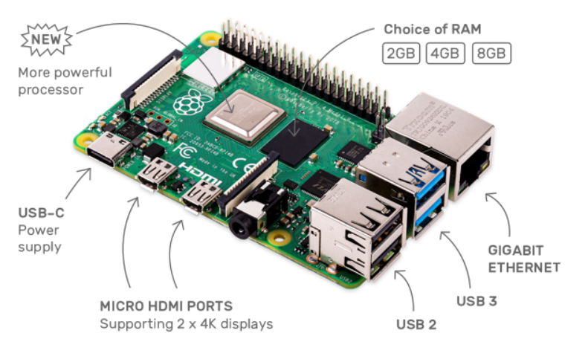
Raspberry pi 4 model B
The speed and performance of the new Raspberry Pi 4 is a step up from earlier models.
Latest product in the Raspberry Pi range, boasting a 64-bit quad core processor running at 1.5GHz, dual-band 2.4GHz and 5GHz wireless LAN, Bluetooth 5.0/BLE, true Gigabit Ethernet, and PoE capability via a separate PoE HAT.

Slide 7
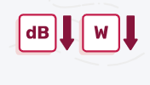

Raspberry pi 4 model B
Features:
Silent and energy efficient: The fanless, energy-efficient Raspberry Pi runs silently and uses far less power than other computers.
Fast Networking: Raspberry Pi 4 comes with Gigabit Ethernet, along with onboard wireless networking and Bluetooth.

Slide 8
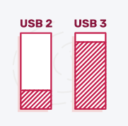
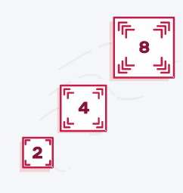
Raspberry pi 4 model B
USB 3: Along with two USB 2 ports you'll find two USB 3 ports, which can transfer data up to ten times faster.
Choice of RAM: Different variants of the Raspberry Pi 4 are available, depending on how much RAM we need — 2GB, 4GB, or 8GB.

Slide 9
Raspberry pi 4 model B
Technical Specifications:
Broadcom BCM2711, Quad core Cortex-A72 (ARM v8) 64-bit SoC @ 1.5GHz
2GB, 4GB or 8GB LPDDR4-3200 SDRAM (depending on model)
2.4 GHz and 5.0 GHz IEEE 802.11ac wireless, Bluetooth 5.0, BLE
Gigabit Ethernet
2 USB 3.0 ports; 2 USB 2.0 ports.
Raspberry Pi standard 40 pin GPIO header (fully backwards compatible with previous boards)
2 × micro-HDMI ports (up to 4kp60 supported)
2-lane MIPI DSI display port
2-lane MIPI CSI camera port
4-pole stereo audio and composite video port
H.265 (4kp60 decode), H264 (1080p60 decode, 1080p30 encode)

Slide 10
Raspberry pi 4 model B
Technical Specifications:
OpenGL ES 3.1, Vulkan 1.0
Micro-SD card slot for loading operating system and data storage
5V DC via USB-C connector (minimum 3A*)
5V DC via GPIO header (minimum 3A*)
Power over Ethernet (PoE) enabled (requires separate PoE HAT)
Operating temperature: 0 – 50 degrees C ambient
A good quality 2.5A power supply can be used if downstream USB peripherals consume less than 500mA in total.

Slide 11
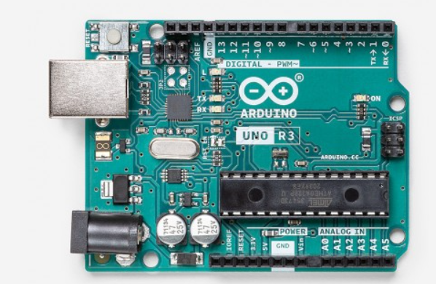
Arduino Uno
Arduino Uno is a microcontroller board based on the ATmega328P .
It has 14 digital input/output pins (of which 6 can be used as PWM outputs), 6 analog inputs, a 16 MHz ceramic resonator (CSTCE16M0V53-R0), a USB connection, a power jack, an ICSP header and a reset button.

Slide 12
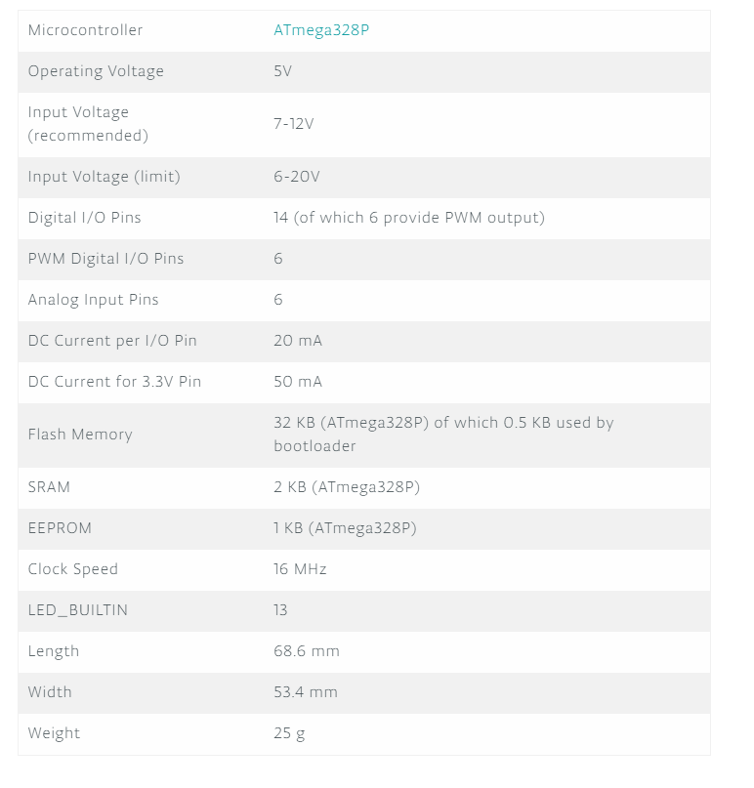
Arduino Uno
Technical Specifications:

Slide 13
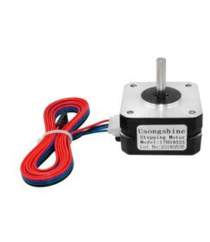
Nema 17 Stepper Motor
17HS4023 Nema 17 42x42x24mm 0.7A Bi-Polar Dual Phase 1.8° Stepper Motor are used very commonly in a lot of 3D printers and RepRap CNC machines. It can also be used in general control machinery, automation and robotics applications.
A NEMA 17 stepper motor is a stepper motor with a 1.7 x 1.7 inch (42.3 x 42.3 mm) faceplate.
The motor conveniently connects via a typical 6 pin JST connector.
This unit comes with a 6-pin female JST to 4 pin female header cable.

Slide 14
Nema 17 Stepper Motor
Technical Specifications:
Phase: 2-phase step drive.
Step angle: 1.8 ± 5% °/Step.
Voltage: 12V.
Current: 700 mA/phase.
Resistance: 4 ± 10% Ω/Phase.
Inductance: 3.2 ± 20% mH/Phase.
Holding Torque: 14 N.cm (1.24 lb.in).
Detent Torque: 2.2 N.cm (0.2 lb.in).
Rotational Inertia: 54 g.cm² (0.3 oz.in²).
Insulation Class: B (see table below for temperatures).
Ambient Temperature Required: -20 to 50°C (-4 to 122°F).

Slide 15
Nema 17 Stepper Motor
Technical Specifications:
Pinout: Red = A+. Green = A. Black = B+. Blue = B. *The two unused pins are “common pins” and are used in uni-polar mode..
Body Dimensions: 41.8 x 41.8 x 23.8 mm (1.65 x 1.65” x 0.94”).
Shaft Diameter: 5mm.
Shaft Length: 21mm.
Weight: 130g (4.6 oz.).

Slide 16
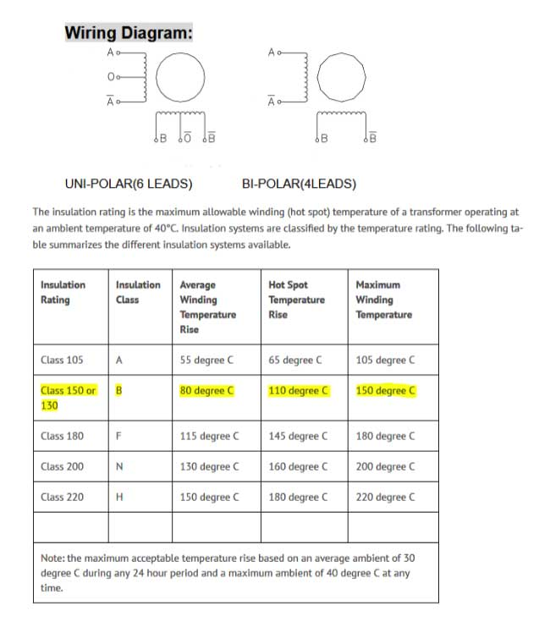
Nema 17 Stepper Motor

Slide 17
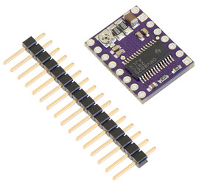
Stepper Driver (DRV8825)
Breakout board for TI’s DRV8825 microstepping bipolar stepper motor driver features adjustable current limiting, over-current and over-temperature protection, and six microstep resolutions (down to 1/32-step).
It operates from 8.2 V to 45 V and can deliver up to approximately 1.5 A per phase without a heat sink or forced air flow (rated for up to 2.2 A per coil with sufficient additional cooling).
The driver has a pinout and interface that are nearly identical to those of A4988 stepper motor driver carriers, so it can be used as a higher-performance drop-in replacement for those boards in many applications.

Slide 18
Stepper Driver (DRV8825)
Motor connections
Four, six, and eight-wire stepper motors can be driven by the DRV8825 if they are properly connected.
Power connections
The driver requires a motor supply voltage of 8.2 – 45 V to be connected across VMOT and GND. This supply should have appropriate decoupling capacitors close to the board, and it should be capable of delivering the expected stepper motor current.

Slide 19
Stepper Driver (DRV8825)
Here are some of the driver’s key features:
Simple step and direction control interface
Six different step resolutions: full-step, half-step, 1/4-step, 1/8-step, 1/16-step, and 1/32-step
Adjustable current control lets you set the maximum current output with a potentiometer, which lets you use voltages above your stepper motor’s rated voltage to achieve higher step rates
Intelligent chopping control that automatically selects the correct current decay mode (fast decay or slow decay)
45 V maximum supply voltage
Built-in regulator (no external logic voltage supply needed)
Can interface directly with 3.3 V and 5 V systems
Over-temperature thermal shutdown, over-current shutdown, and under-voltage lockout
Short-to-ground and shorted-load protection
4-layer, 2 oz copper PCB for improved heat dissipation
Exposed solderable ground pad below the driver IC on the bottom of the PCB

Slide 20
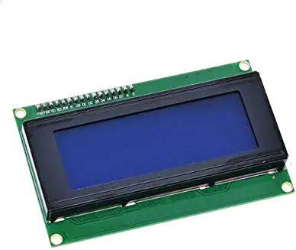
HD44780 series LCD Display (20*4)
Features:
20 characters wide, 4 rows
White text on blue background
Connection port is 0.1" pitch, single row for easy breadboarding and wiring
Single LED backlight with a resistor included, we can power it directly from 5V. It can be dimmed easily with a resistor or PWM and uses much less power than LCD with EL (electroluminescent) backlights
Can be fully controlled with only 6 digital lines
Built in character set supports English/Japanese text.
Up to 8 extra characters can be created.
Comes with necessary contrast potentiometer and strip of header

Slide 21
HD44780 series LCD Display (20*4)
Specifications:
Background Color:Blue
Character Format:5 x 8 Dots
Character Size:4.75mm H x 2.95mm W
Display Format:20 x 4
Display Mode:Transflective
Display Type:STN - Super-Twisted Nematic
Dot Size:0.55mm W x 0.55mm H
Interface:Parallel, 8-Bit
Number of Characters:80
Operating Temperature:-10°C ~ 60°C
Outline L x W x H:97.00mm x 60.00mm x 14.00mm
Text Color:White
Viewing Area:76.00mm L x 26.00mm W and Voltage - Supply:5V

Slide 22
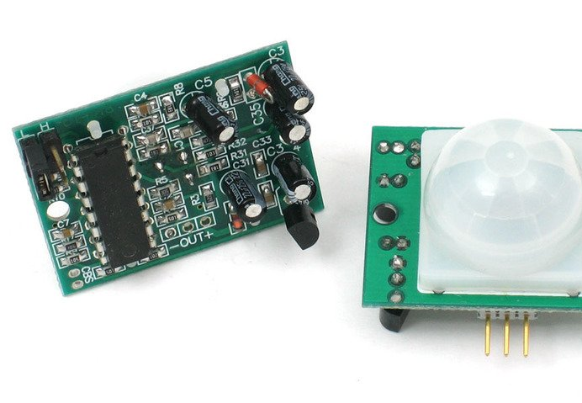
PIR Motion Sensor
PIR sensors allow you to sense motion, almost always used to detect whether a human has moved in or out of the sensors range.
They are small, inexpensive, low-power, easy to use and don't wear out. They are often referred to as PIR, "Passive Infrared", "Pyroelectric", or "IR motion" sensors.

Slide 23
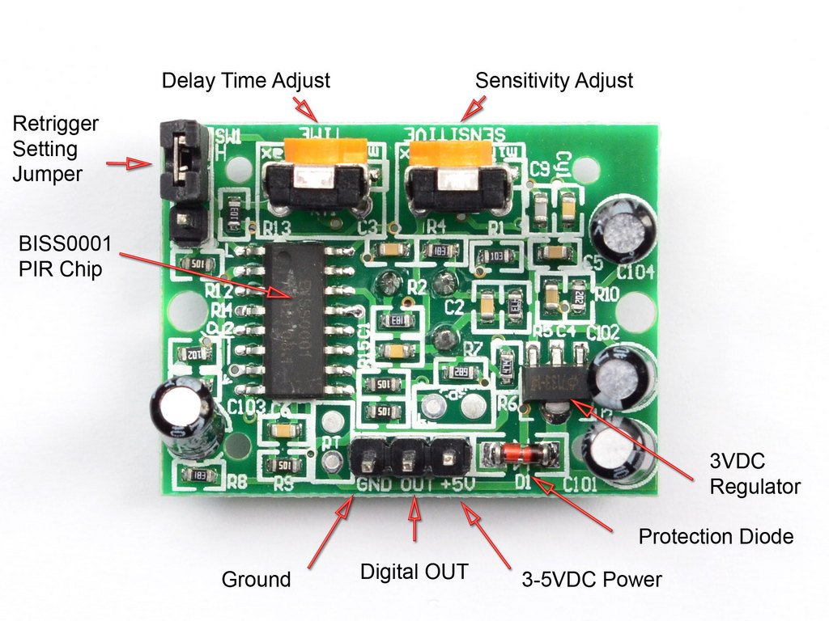
PIR Motion Sensor
PIRs are basically made of a pyroelectric sensor (round metal can with a rectangular crystal in the center), which can detect levels of infrared radiation. Everything emits some low level radiation, and the hotter something is, the more radiation is emitted. The sensor in a motion detector is actually split in two halves.
The reason for that is that we are looking to detect motion (change) not average IR levels. The two halves are wired up so that they cancel each other out. If one half sees more or less IR radiation than the other, the output will swing high or low.

Slide 24
PIR Motion Sensor
Specifications:
Output: Digital pulse high (3V) when triggered (motion detected) digital low when idle (no motion detected). Pulse lengths are determined by resistors and capacitors on the PCB and differ from sensor to sensor.
Sensitivity range: up to 20 feet (6 meters) 110° x 70° detection range.
Power supply: 5V-12V input voltage for most modules (they have a 3.3V regulator), but 5V is ideal in case the regulator has different specs.

Slide 25
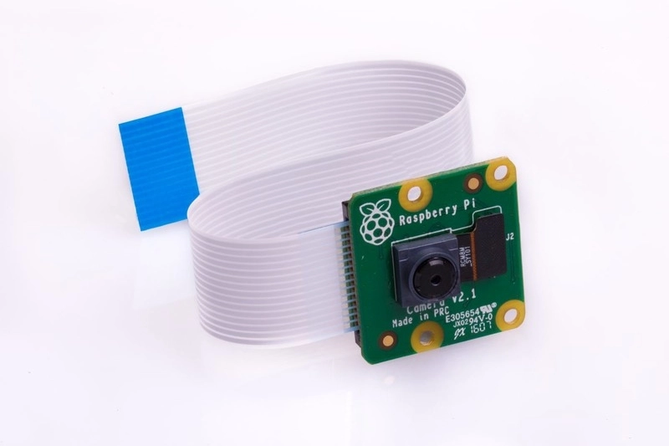
Raspberry pi Camera V2 – 8MP
The v2 Camera Module has a Sony IMX219 8-megapixel sensor.
The Camera Module can be used to take high-definition video, as well as stills photographs.
The camera works with all models of Raspberry Pi 1, 2, 3 and 4. It can be accessed through the MMAL and V4L APIs, and there are numerous third-party libraries built for it, including the Picamera Python library.

Slide 26
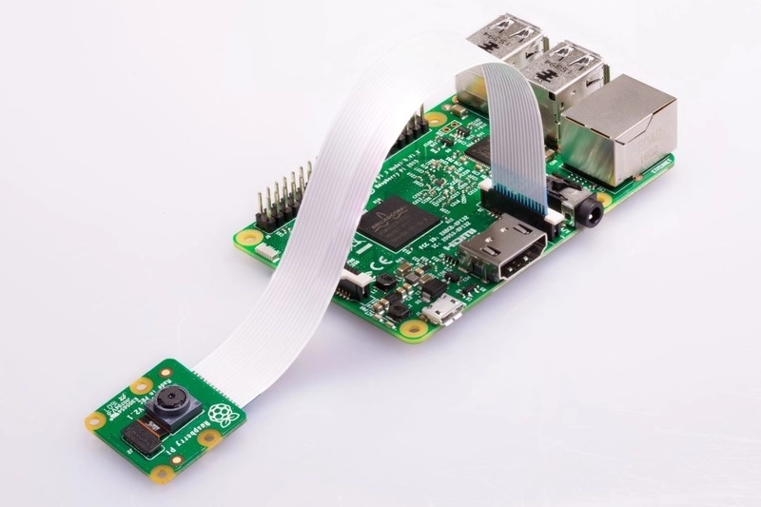
Raspberry pi Camera V2 – 8MP
Specifications:
8 megapixel camera capable of taking photographs of 3280 x 2464 pixels
Capture video at 1080p30, 720p60 and 640x480p90 resolutions
All software is supported within the latest version of Raspbian Operating System
Applications: CCTV security camera, motion detection, time lapse photography

Slide 27
Raspberry pi Camera V2 – 8MP
Features:
Fixed focus lens on-board
8 megapixel native resolution sensor-capable of 3280 x 2464 pixel static images
Supports 1080p30, 720p60 and 640x480p90 video
Size 25mm x 23mm x 9mm
Weight just over 3g
Connects to the Raspberry Pi board via a short ribbon cable

Slide 28
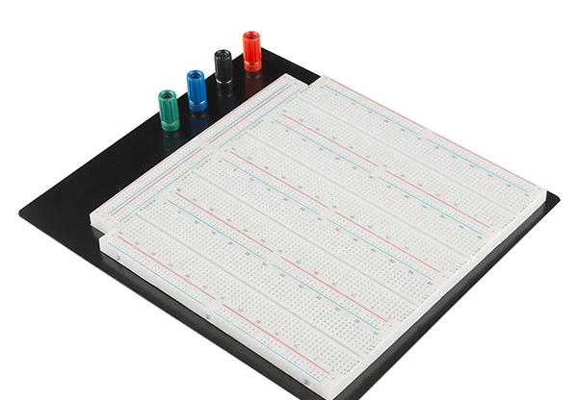
Breadboard and Jumper Wires
Breadboard:
This is solderless breadboard! It has 7 power buses, 40 columns, and 63 rows - with a total of 3220 tie in points. All pins are spaced by a standard 0.1". The two sets of five columns are separated by about 0.3". The board accepts wire sizes in the range of 20-29AWG.
This board also has 4 binding posts, a black aluminum plate backing, and 4 rubber standoffs to keep the breadboard suspended safely on the workstation.
Dimensions: 9.25 x 8.0 x 1.25" (234.95 x 203.2 x 31.75mm).

Slide 29
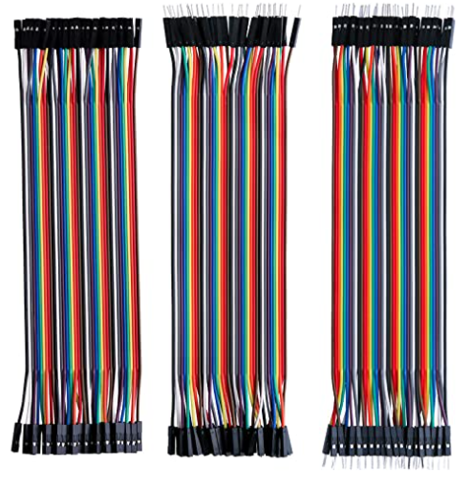
Breadboard and Jumper Wires
Jumper Wires:
Each cable length: about 20 cm /8-inch
The cables can be separated to form an assembly containing the number of wires you require for your connection and to support non-standard odd-spaced headers

Slide 30
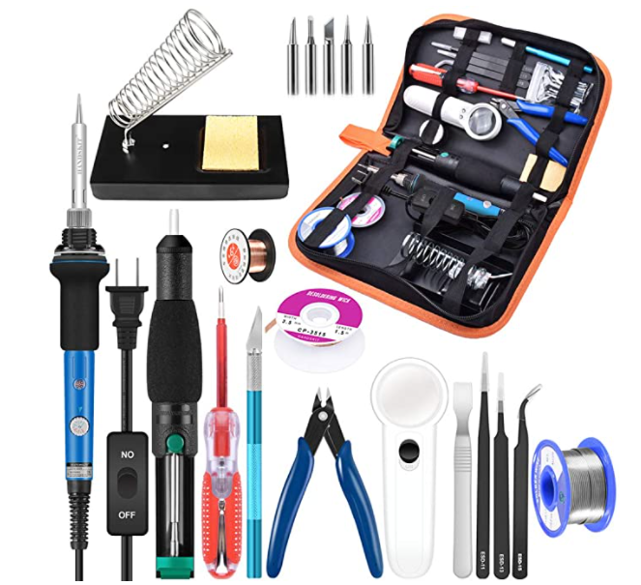
Soldering Kit
Soldering iron kit comes with soldering iron, solder wire, desoldering pump, solder wick, stand with cleaning sponge, 5 different soldering tips, 3 anti-static tweezers, copper wire, magnifier, screwdrivers(electric pen), knife

Slide 31
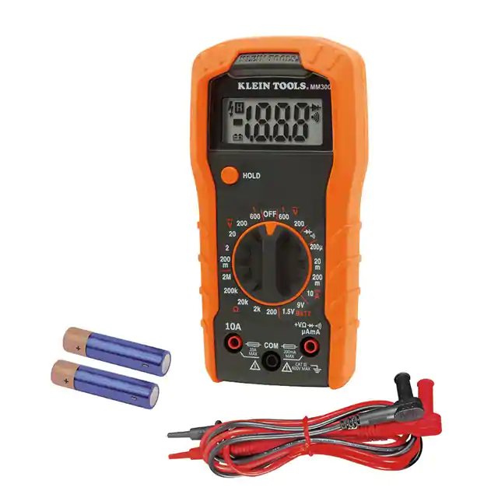
Digital Multimeter
Manual Average Handheld Digital (DMM) Multimeter 3.5 Digit LCD Display Voltage, Current, Resistance Battery Test, Continuity, Diode Test Function Features Hold

Slide 32
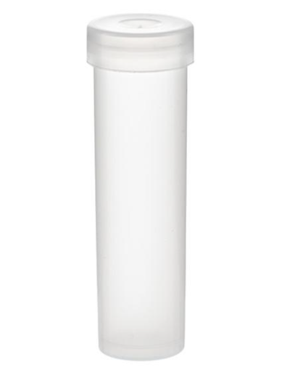
Medicine Boxes
Molded from polyethylene plastic
Will not alter the flavor or quality of the contents

Slide 33
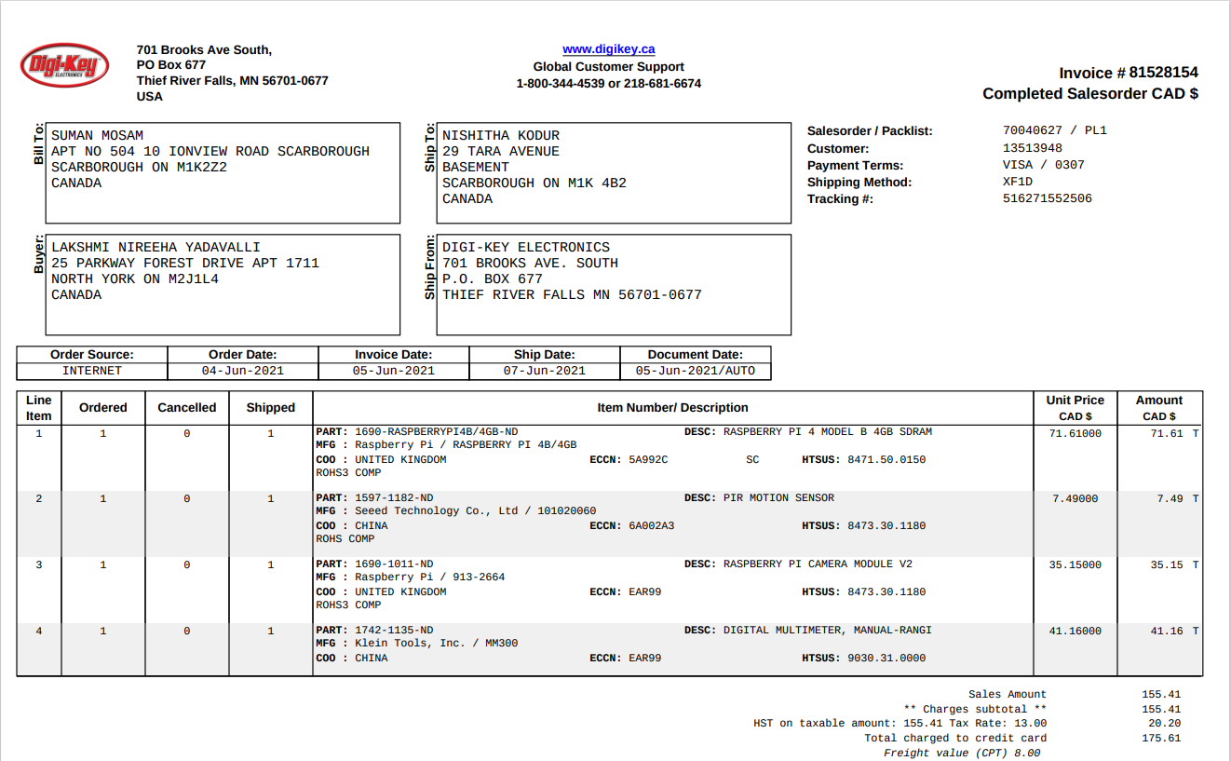

Slide 34
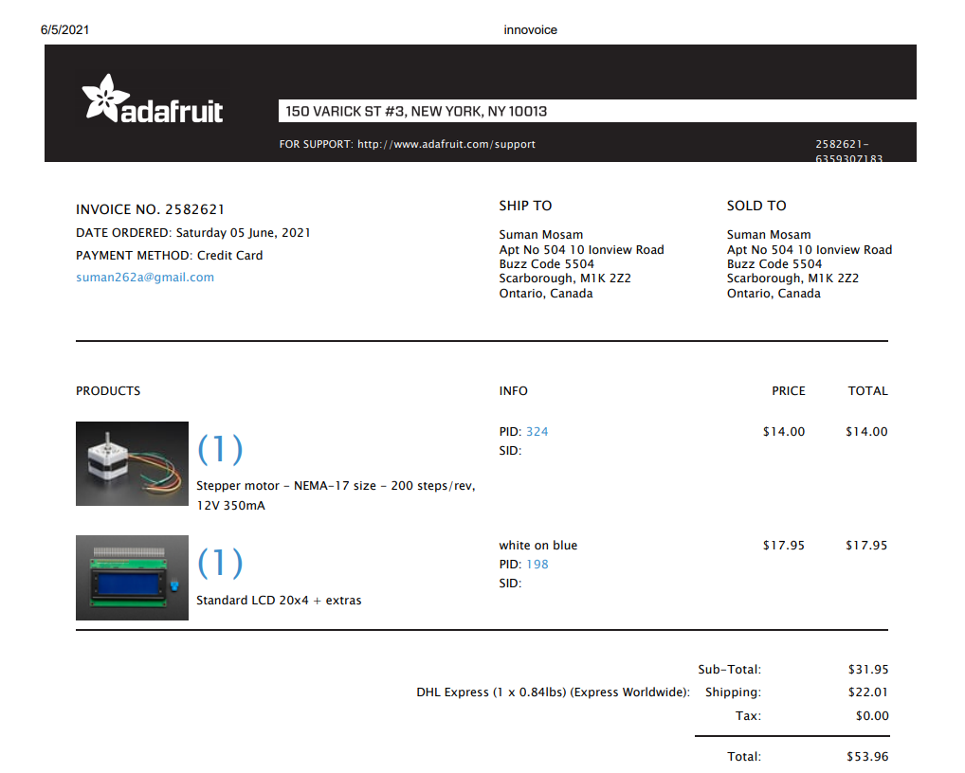

Slide 35
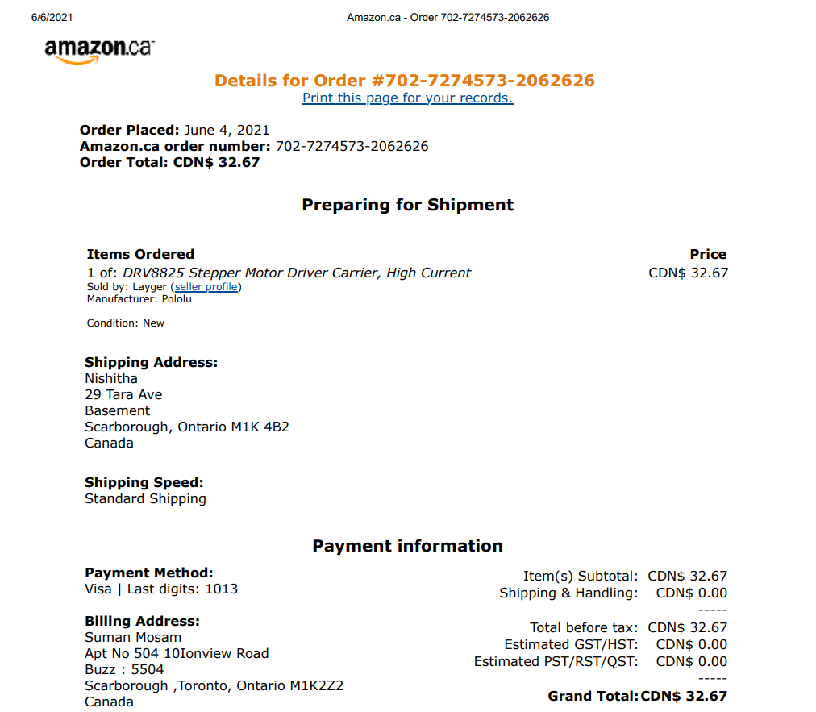

Slide 36
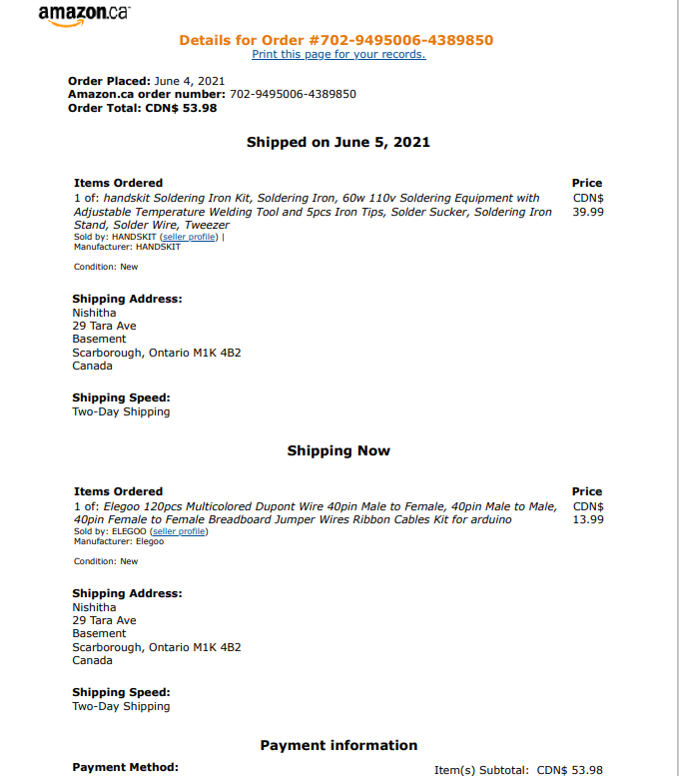

Slide 37
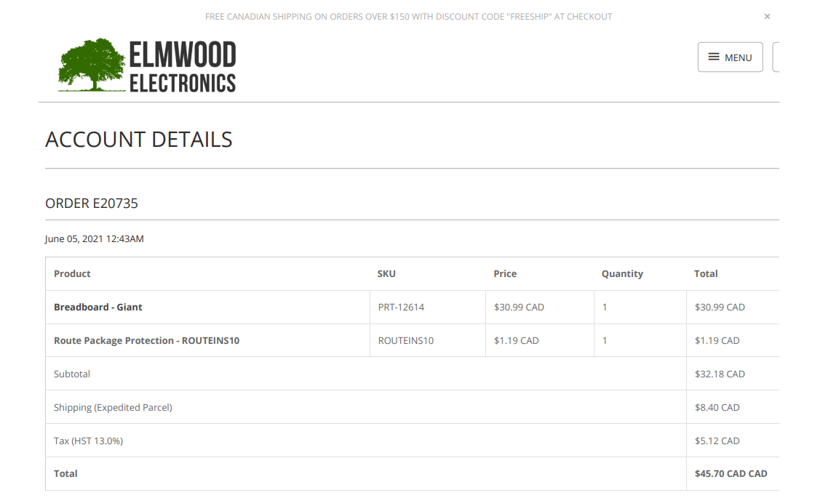

Slide 38
References
ABRA. (n.d.). 17HS4023 Nema 17 42x42x24mm 0.7A Bi-Polar Dual Phase 1.8° Stepper Motor .
Retrieved from ABRA electronics: https://abra-electronics.com/electromechanical/motors/stepper-motors/nema-
17/mot-17hs4023-17hs4023-nema-17-43mm-1.8a-dual-phase-stepper-motor-1.8.html
Ada, L. (2014, Januray 28). How PIRs Work.
Retrieved from Adafruit: https://learn.adafruit.com/pir-passive-infrared-proximity-motion-sensor/how-pirs-work
Ada, L. (2014, January 28). PIR Motion Sensor.
Retrieved from Adafruit: https://learn.adafruit.com/pir-passive-infrared-proximity-motion-sensor
Amazon. (n.d.). Alexa and Echo devices are designed to protect your privacy.
Retrieved from Amazon: https://www.amazon.ca/b/?language=en_CA&node=19314790011&ref=ods_aucc_dp_pa_enca_privacy
Amazon. (n.d.). Echo Dot (3rd gen) - Smart speaker with Alexa - Charcoal.
Retrieved from amazon: https://www.amazon.ca/Echo-Dot-3rd-gen-
Charcoal/dp/B07PDHT5XP/ref=sr_1_1?dchild=1&keywords=Echo%2BDot&qid=1622912359&sr=8-1&th=1
Amazon. (n.d.). Handskit Soldering Iron Kit.
Retrieved from Amazon Canada: https://www.amazon.ca/handskit-Soldering-Equipment-Adjustable-
Temperature/dp/B01N46T138/ref=sr_1_6?dchild=1&keywords=electronic+soldering+kit&qid=1622735853&sr=8-6

Slide 39
Arduino. (n.d.). Arduino Uno Rev3.
Retrieved from Arduino Store: https://store.arduino.cc/usa/arduino-uno-rev3
BuyaPi. (n.d.). Raspberry Pi 4 Model B/4GB.
Retrieved from BuyaPi.ca: https://www.buyapi.ca/product/raspberry-pi-4-model-b-4gb/
BuyaPi. (n.d.). Raspberry Pi Camera V2 - 8MP.
Retrieved from BuyaPi: https://www.buyapi.ca/product/raspberry-pi-8mp-camera-board-v2/
Digi Key. (n.d.). MM300.
Retrieved from DigiKey Electronics: https://www.digikey.ca/en/products/detail/klein-tools-inc/MM300/6597021
Digi-Key. (n.d.). Standard LCD 20x4 Plus Extras White on Blue Board.
Retrieved from Digi-Key Electronics: https://www.digikey.ca/catalog/en/partgroup/standard-lcd-20x4-plus-extras-white-on-blue-board/59402
ELMWOOD . (n.d.). BREADBOARD - GIANT.
Retrieved from ELMWOOD ELECTRONICS: https://elmwoodelectronics.ca/products/12614

Slide 40
Pololu. (n.d.). DRV8825 Stepper Motor Driver Carrier, High Current.
Retrieved from Polulu Robotics & Electronics: https://www.pololu.com/product/2133
Raspberry pi. (2016, April). Camera Module V2.
Retrieved from Raspberry pi Products: https://www.raspberrypi.org/products/camera-module-v2/
Raspberry pi. (n.d.). Raspberrypi 4.
Retrieved from Raspberrypi Products: https://www.raspberrypi.org/products/raspberry-pi-4-model-b/
Raspberrypi. (n.d.). Raspberrypi 4 Tech Specs.
Retrieved from Raspberrypi Products: https://www.raspberrypi.org/products/raspberry-pi-4-model-b/specifications/
TheContatinerStore. (n.d.). Nalgene Snap Closure Travel Vials.
Retrieved from TheContainerStore: https://www.containerstore.com/s/bath/medication-storage/nalgene-snap-closure-travel-vials/12d?productId=10018277

